Slide 1
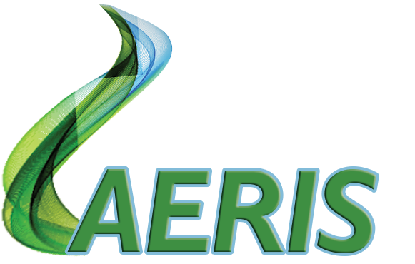
Aeris Energy LLC
BUILDING TOMORROW’S POWER, TODAY

Slide 2
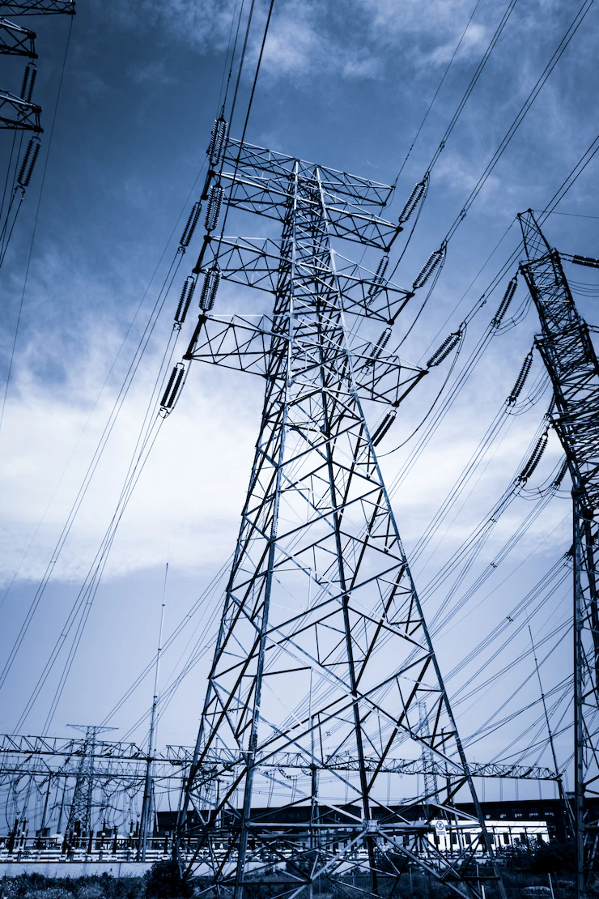
OUR MISSION
America’s Power Infrastructure, is antiquated and significantly underperforming. Whether it is the unreliability of our electric production and transmission system; the severity of fossil fuels on our environment; the costs associated with clean-up of now defunct facilities and the damage they left in their wake, it is clear that a change is needed if we are to avoid the problems of typical third-world countries.
With robust support from our business partners and investors, steady and consistent focus, and pursuit of technological advancements, we dedicate ourselves to leveraging cutting-edge technology for the improvement and fortification of America’s energy system.
Simultaneously, we aim to deliver appealing financial returns to foster sustained growth and investor loyalty.
Recognizing the gradual nature of this transformation and the continuous evolution of technology, our practical timeline extends to 2075-3000. Your support is indispensable to the success of Repowering America by 3000.

Slide 3
RAPIDLY ESCALATING DEMAND & OUTDATED INFRASTRUCTURE CREATE OPPORTUNITIES IN POWER INDUSTRY
“Upgrading the grid won’t be cheap or easy. Consultancy Marsh & McLennan estimates that more than 140,000 miles of U.S. transmission lines will need to be replaced by 2050, which alone could cost $700 billion. In all, the fixes and upgrades needed to maintain “a transmission system capable of dealing with the nation’s future needs” will cost more than $1 trillion, the 2020 study concluded. A Princeton University study the same year estimated much higher costs – about $2.4 trillion by 2050.” – Reuters
“Data center power consumption in the US is set to reach 35GW by the end of the decade, almost double its 2022 level…..
Existing markets are already struggling to meet demand, the report says. In Northern Virginia, the largest data center market in the world at 3,400MW, availability is running at just 0.2 percent.
Upcoming developments in the state include a 72MW campus in Leesburg, which is being built by Stack Infrastructure. Announced earlier this month, it is due to start coming online in the first half of 2025.
Other popular areas face similar challenges, the report says, with availability in the Bay Area around San Francisco running at 0.5 percent of capacity, while availability in Dallas Forth Worth is 1.9 percent and in Phoenix, Arizona, it’s 3.8 percent.– Data Center Dynamics
The demands on the electrical generation and transmission network across the US are escalating rapidly. Emerging technologies such as artificial intelligence, crypto currency and the widespread use of electric vehicles are placing an unprecedented burden on an already strained infrastructure. These technologies, along with the existing power demand, require extensive energy that cannot be provided within the limitations of outdated generation.
The network is further hampered by an aging grid network that does not have the capacity to deliver the required electrical load, especially in rural America.
Weather risks and political unrest also threaten its already fragile stability.
Any investments needed to improve the existing system are usually quite significant hindering or halting even small economic development projects and growth.

Slide 4
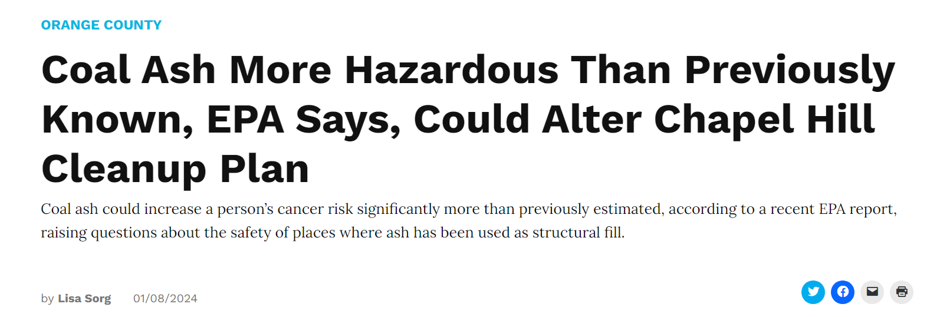
fOSSIL FUELS SCARCity Causes Both COSTS & ENVIRONMENTAL CONCERNS TO ESCALATE
The extraction, processing and transportation of oil and other fossil fuels can result in environmental pollution. Oil spills (whether from offshore drilling or pipeline leaks), mining, drilling and operations can have severe consequences for ecosystems, harming wildlife and disrupting aquatic environments.
Burning fossil fuels, including oil, releases carbon dioxide (CO2) and other greenhouse gases into the atmosphere. These gases contribute to global warming and climate change, leading to adverse effects on weather patterns, sea levels, and overall environmental instability.
Fossil Fuels are a finite resource and their extraction can lead to resource depletion. As easily accessible reserves are exhausted, companies may resort to more environmentally damaging methods or more pristine locations.
The global economy can be sensitive to fluctuations in fossil fuel prices. Dependence on oil, for example, can make economies vulnerable to price volatility, affecting industries, inflation, and overall economic stability.
The control and distribution of resources can lead to geopolitical tensions and conflicts. Countries may engage in competition or disputes over regions, leading to instability and potential military conflicts.

Slide 5
SOLAR AND WIND CAN’T INTEGRATE INTO AN ANTIQUATED DISTRIBUTION NETWORK
“…Manufacturing solar panels is a dirty process from start to finish. Mining quartz for silicon causes the lung disease silicosis, and the production of solar cells uses a lot of energy, water, and toxic chemicals.
The other issue is that solar cells have a guaranteed life expectancy of about 25 years, with average efficiency losses of 0.5% per year. If replacement begins after 25 years, time is running out for all the panels that were installed during the early 2000s boom. The International Renewable Energy Agency (IREA) projects that by 2050, we’ll be looking at 78 million metric tons of bulky e-waste. The IREA also believe that we’ll be generating six million metric tons of new solar e-waste every year by then, too. Unfortunately, there are hardly any measures in place to recycle solar panels, at least in the US…”
The integration of solar and wind energy into the antiquated transmission distribution system of electric power in the USA presents significant challenges.
The existing power grid was primarily designed to accommodate centralized, fossil fuel-based power generation, and its infrastructure is often ill-equipped to handle the decentralized and intermittent nature of renewable sources.
The variability in solar and wind energy production poses a challenge for grid operators, as these sources depend on weather conditions.
Additionally, the geographical misalignment between areas with high renewable energy potential and population centers creates transmission inefficiencies.
The outdated grid infrastructure may lack the necessary flexibility and smart technologies required to manage the fluctuations in power generation from renewables efficiently.
Upgrading the transmission and distribution system to better integrate solar and wind power is crucial for harnessing the full potential of clean energy, promoting grid resilience, and transitioning toward a sustainable energy future.

Slide 6
PFAS – THE FOREVER CHEMICAL
Polyfluoroalkyl substances (PFAS) constitute a group of synthetic chemicals characterized by strong carbon-fluorine bonds, rendering them highly resistant to degradation. PFAS are widely utilized in various industrial and consumer products for their unique water-resistant and grease-resistant properties.
Common applications include non-stick coatings, water repellents, and firefighting foams.
The persistent nature of PFAS in the environment has led to concerns about their widespread contamination of water sources and soil, raising health and environmental issues. Due to their stability and resistance to breakdown, PFAS are often referred to as "forever chemicals," contributing to their enduring presence and potential adverse effects on human health and ecosystems.
The collective impact of PFAS contamination, oil spills, and hazardous waste from shuttered facilities necessitates extensive cleanup efforts and preventive measures.
Governments and industries must invest significant resources in remediation projects and regulatory frameworks to address these environmental challenges. These financial commitments divert funds that could otherwise be allocated to sustainable development initiatives, hindering progress in areas such as renewable energy, conservation efforts, and environmental education.

Slide 7
Aeris Energy LLC Brings A Solution
Key Experience PARTNERS
Risk Management
Aeris Energy LLC is a visionary team comprising specialists in various domains. It is adept at navigating the intricate landscape of alternative energy with proficiency spanning development, marketing, finance, legal, human resources, technology, alternative energy, risk management, and new business development.
Aeris’s strategic prowess extends from formulating broad visions to meticulous micro-planning, ensuring that every Aeris project aligns seamlessly with the goals and objectives of our investors and the need and opportunities of the market.
Under the forward-thinking leadership of founders Will Stone, CEO, John DeLuca, CFO, and Ben Kuenne, Vice President of Operations, Aeris Energy LLC and its team of seasoned professionals recognized emerging trends within the power and energy field over a decade ago and proactively initiated the development of an innovative solution. By investing time, resources, and expertise into crafting a solution well in advance, it has positioned itself to become the leader in alternative energy solutions with the introduction of Phoenix Energy.

Slide 8
Phoenix Energy System
No Emissions
No Fossil Fuel
No Carbon Footprint
No Air and Water Permits Required
No Smoke Stacks or Tall Buildings
No Radiation
Easily Expandable
Value-added By-products
Affordable and Sustainable,
Cost-Effective
Efficient Time-to-Market
Phoenix is a new type of renewable power that utilizes the synergy of well-established technologies from two industries: The induction heating technology from the steel industry which has been available since 1920 and a boiling water reactor technology from nuclear submarines which has been available since 1954.
Blended together in a proprietary way, this new system offers many benefits including:
No Emissions, No Fossil Fuel, No Carbon Footprint, No Air and Water Permits Required, No Smoke Stacks or Tall Buildings, No Radiation, Easily Expandable, Value-added By-products, Affordable and Sustainable, Cost-Effective & Time-to-Market.
Aside from affordable and abundant green power production, The Phoenix technology has many ancillary benefits, such as the ability to clean contaminated soil and water while producing energy, including substances laced with forever chemicals like PFAS. Production of value-added by-products such as liquid hydrogen, medical grade water, ammonia and more provide opportunities for additional income generating opportunities.

Slide 9
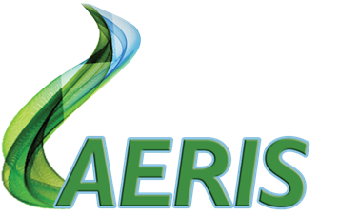
John Deluca
Founder & CFO
jdeluca8@gmail.com
586.515.3144
PHOENIX ENERGY CENTER PROCESS
3MW
Solar Panel
Start-up
Aquaponics Operations
Wastewater
Gray Water
Necessary
additives/
minerals
reinjected
PFAS
Phoenix
Induction
25 MW
Steam/Electric Turbine
Electrical Grid
Necessary
additives/
minerals
reinjected
Well Water
Hydrogen
Electrolysis
Ammonia Production
Storage
Water Bottling Operations
Battery Storage
Storage
Liquid Hydrogen Production
KEY:
Gas Flow
Electricity Flow
Water Flow
Medical Grade Water Production
Electrical Grid
Green Steel Production
Income Generating By-products

Slide 10
MOVING TOWARDS 3000
Over the next 24 months, Aeris is embarking on an ambitious venture to spearhead the development of four specific projects poised for integration of Phoenix Energy.
These projects are located in:
Escanaba, Michigan (Redevelopment of a retired coal plant to provide for city-wide alternative energy mandate)
Gwinn, Michigan (Reuse of unique Air Force buildings into state-of-the-art data centers)
Gwinn, Michigan (Development of Technology Development Center)
Kingsford, Michigan (Rice Juice Acquisition)

Slide 11
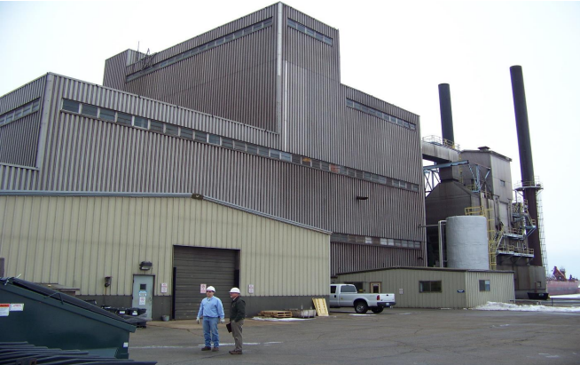
Escanaba Project
The Escanaba Project and Gwinn Project are located within 90 minutes of each other which allows for easy management of both projects.
The Escanaba project is 25 MW former coal plant which was shuttered in 2013. The plant, which at one time, provided power to the city, is now abandoned and utilized as a scrap yard. Existing and turbines make this site desirable and affordable as either a
Low Conversion Cost & Benefits:
• Zero Warm water Discharge • Zero Brine Discharge • Zero Emissions • Extremely low Power Production Costs • Ability to operate as either a Base or Peak load Plant • Production of Power available 24 hrs a Day 7 Days a Week 345 Days a Year • Retention and future use of valuable Plant Equipment and Assets (Interconnection and Delivery Equipment, Turbine Generators, facility, Staff, Etc ) • Massive Reduction in Compliance Issues • Elimination of Costly Remediation Issues potentially arising from Future Plant Closure • Compact Nature of PENV’s Plant Designs allow for substantial future growth at existing site • Short Conversion Time 7 to 12 Months • Unlimited Extension of Plants usable Lifespan
Escanaba Power Station

Slide 12
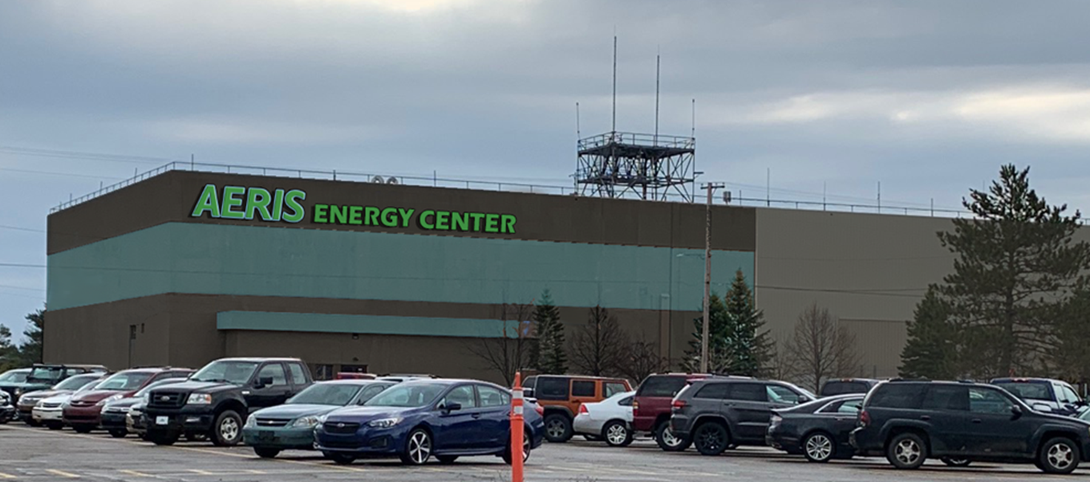
Gwinn Project
The former K.I. Sawyer Air Force Base, now known as Marquette Sawyer Regional Airport is primarily owned by Mango Investments.
Mango has entered into a joint venture agreement with Aeris to maximize the value of approximately 600,000 sf of existing commercial facilities and 1,000 acres of developable sites.
Due to inadequate transmission, power access is a challenge. The building however are uniquely positioned to be highly sought after, particularly in the data center and crypto fields.
A fortune 100 company is ready to occupy these properties as data centers serving military and government clients. The company has toured the property and met with all utility and local stakeholders. It is more than satisfied with natural gas, water/wastewater, telecommunications and internet, which have been pre-approved by the DOD. The electric is a challenge. The company has also indicated a need to work with Aeris providing similar electrical solutions in other parts of the world.

Slide 13
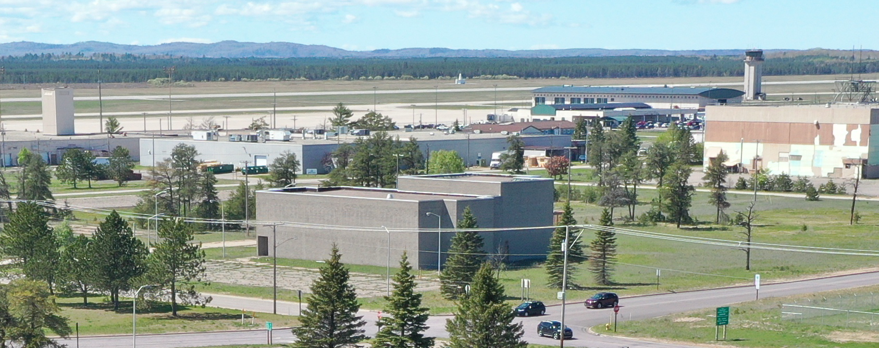
GWINN PROJECT – PHASE I
Install Phoenix Units to produce 25 MW energy
The system is be built in an approximately 10,000 sf building and will provide energy to immediate users located in close proximity to the building via underground pipes
In addition to providing electricity at a consistent level well below the market rate, the system has the additional benefit of water purification. It can operate on any level of contaminated liquid and will produce a by product of medical grade water to be sold for $25 per 10 grams and to provide for a aquaponics environment that produces fish and vegetables.
Currently preliminary plans and cost estimates are being developed by CCC Group, Inc., contractors for the building renovation.

Slide 14
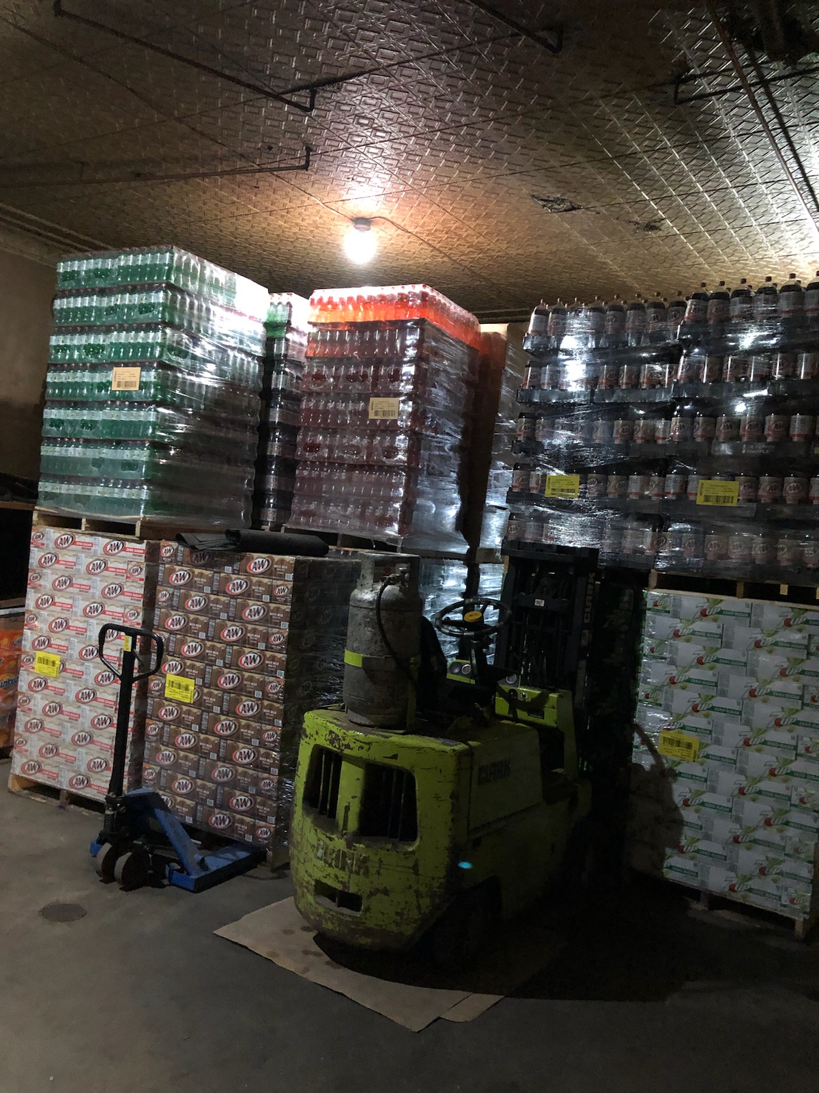
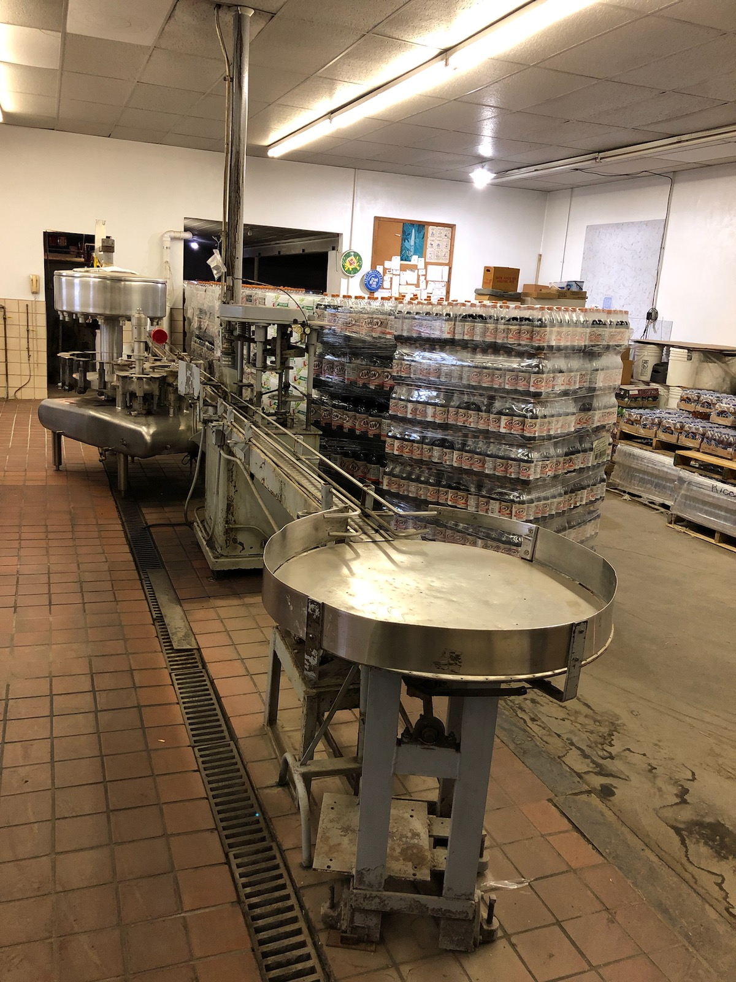
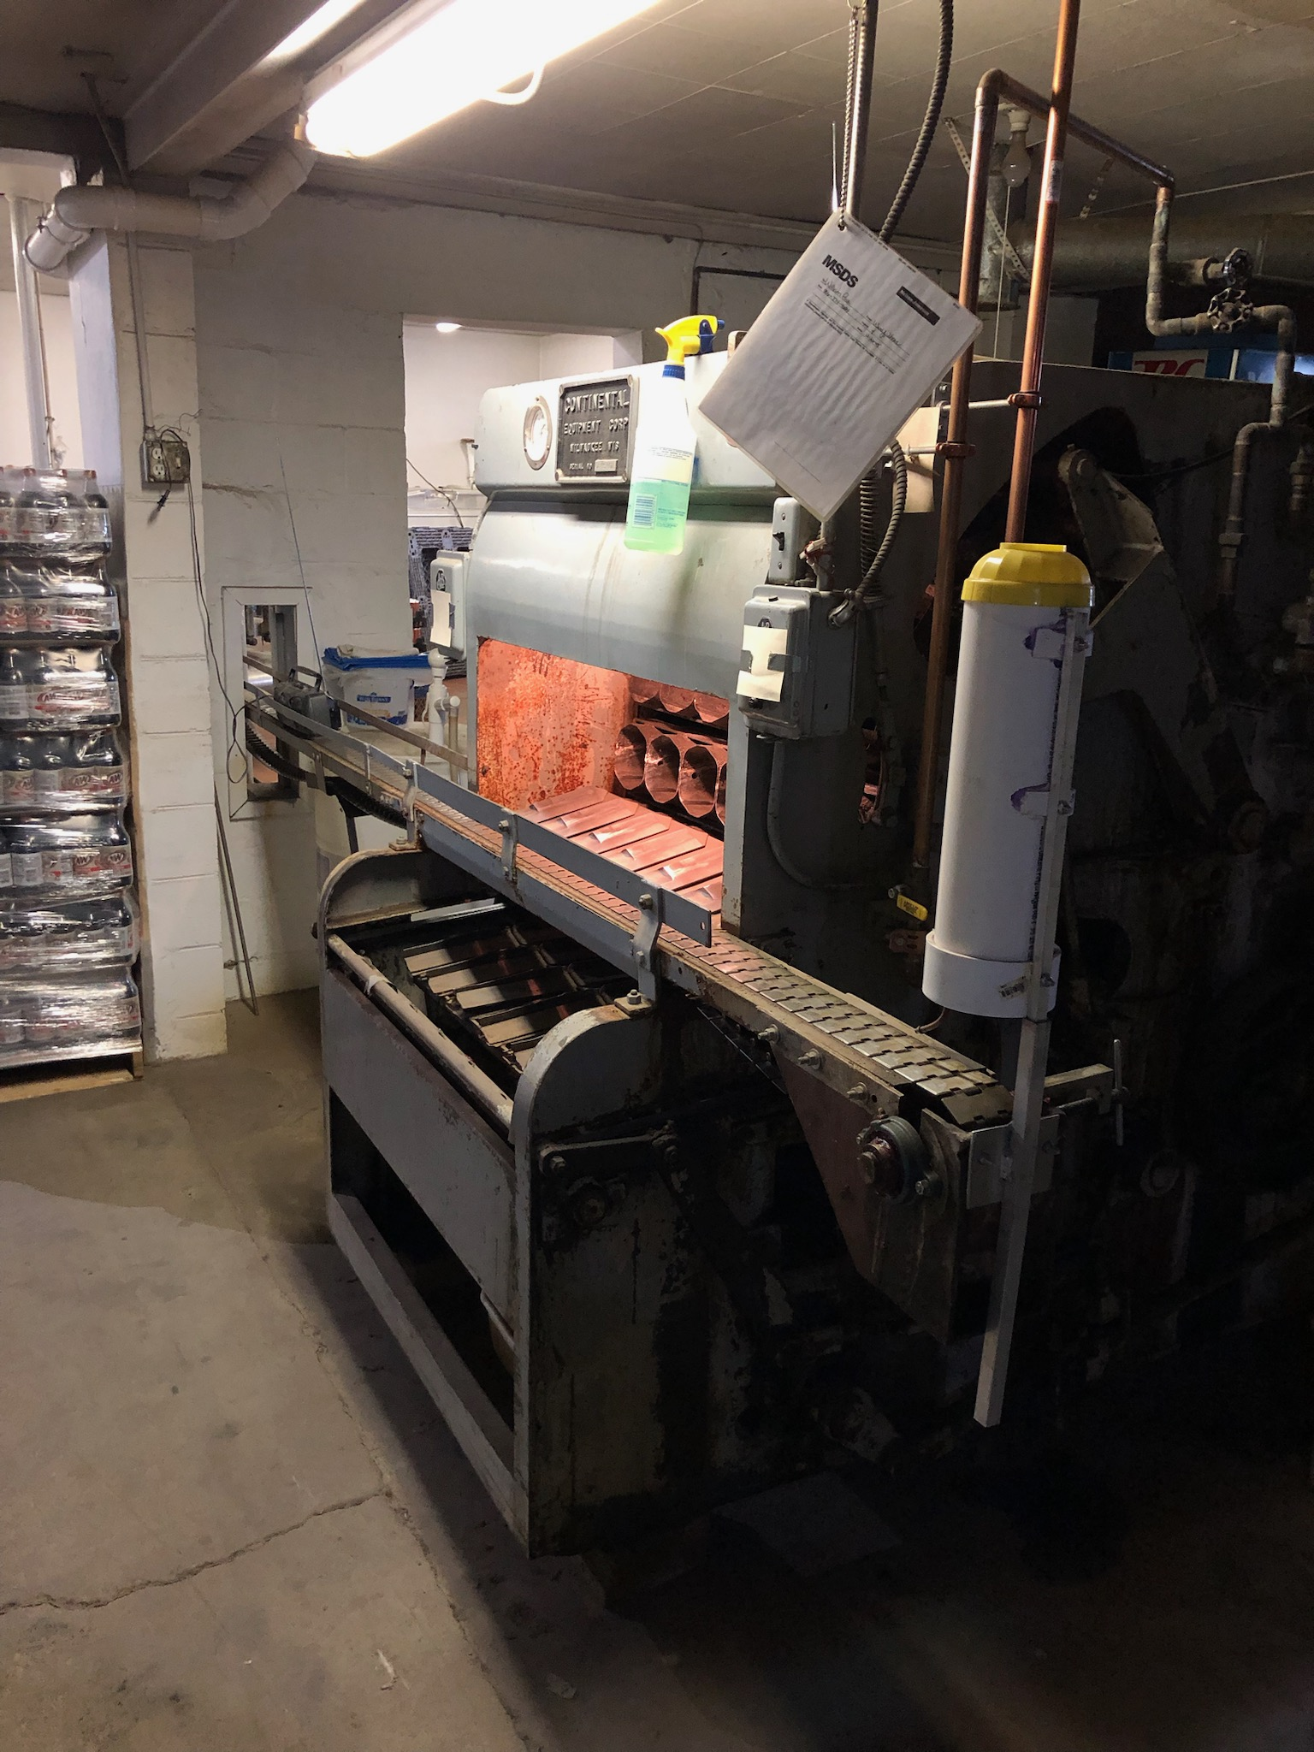
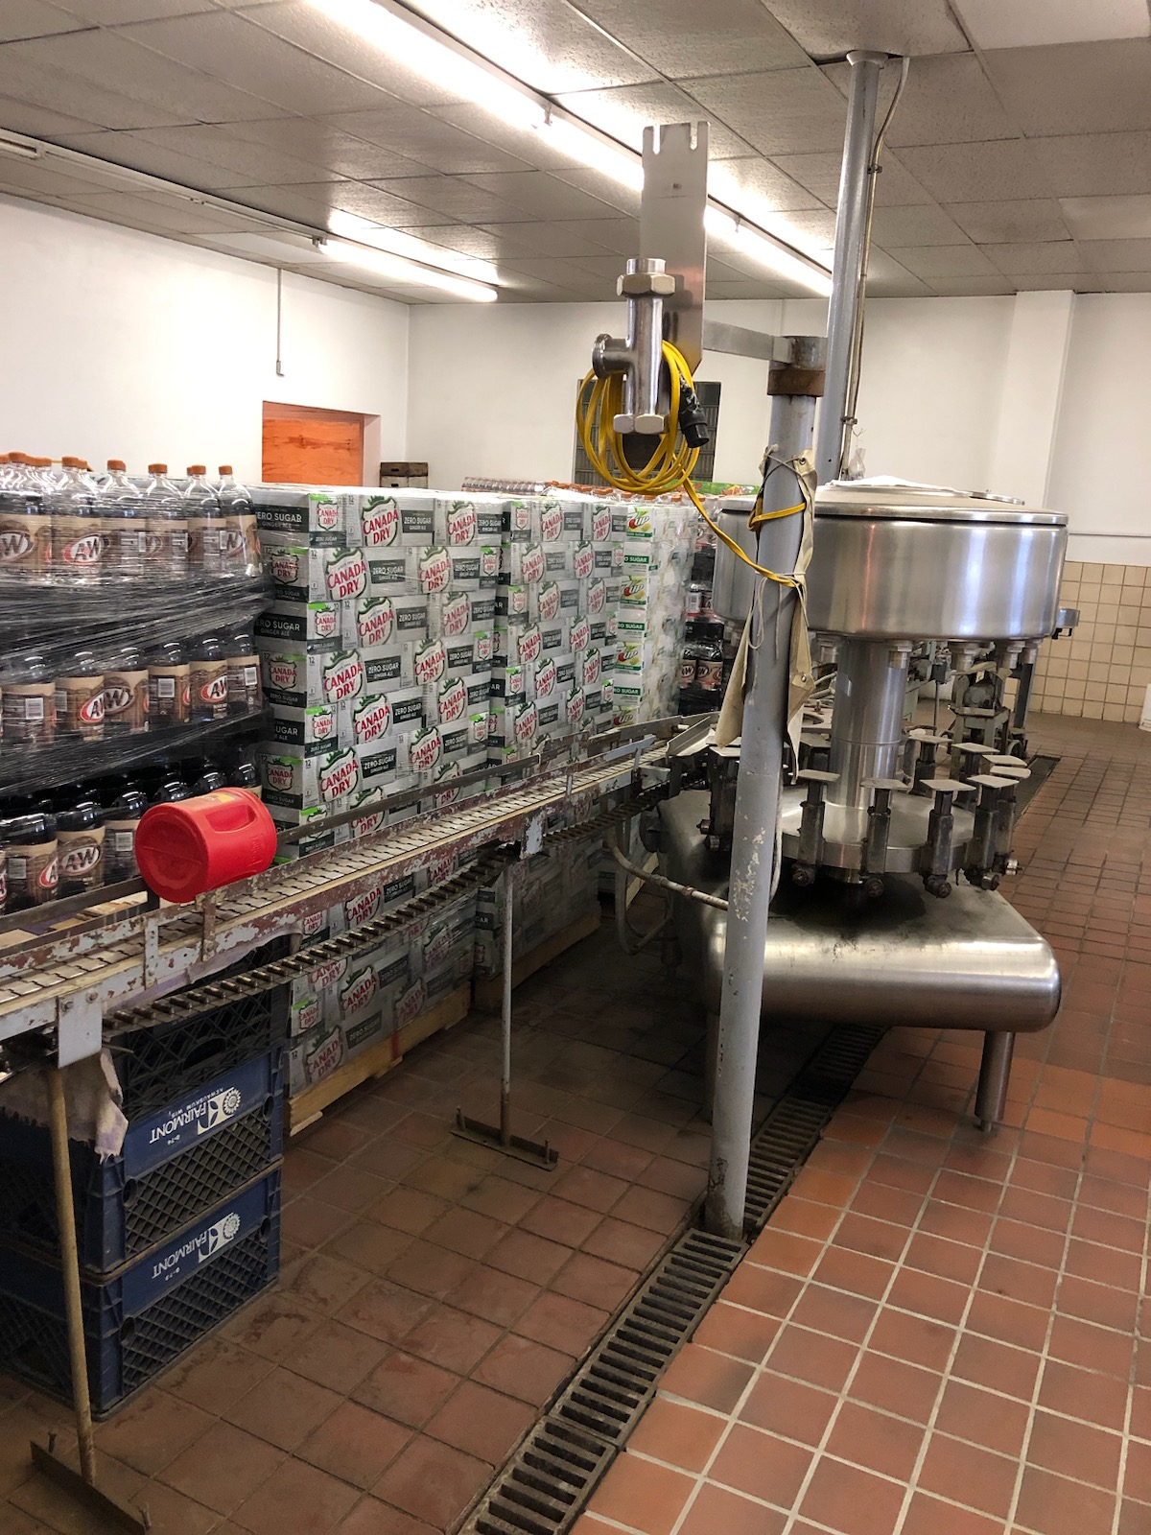
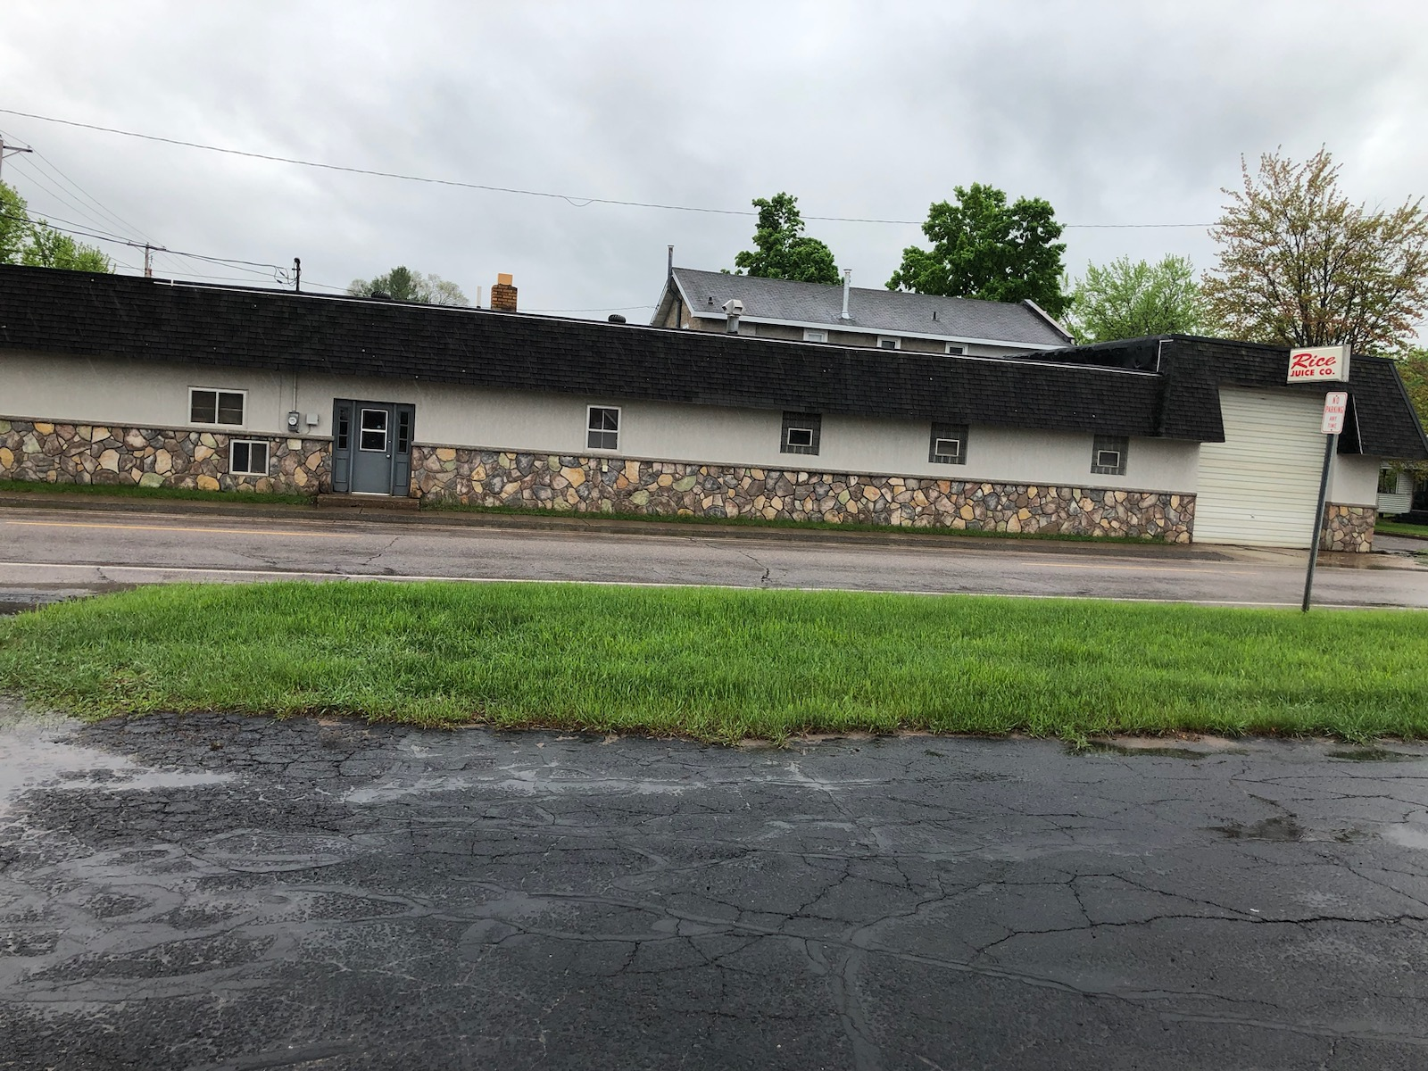
Rice Juice Co. Acquistion
Rice Juice Company was founded in 1951 and has grown to be a leading bottling plant and distribution company for name brands like 7-UP, A&W, BAI and more.
It is located in close proximity to the energy site in Kingsford, Michigan.
This strategic acquisition will provide for instant income generation. It will also serve to provide both a distribution system and bottling solution for our medical grade water.

Slide 15
REPOWER AMERICA 3000 Innovation Center & PartNers
Working with Mango Investments and Emerge Alliance, we would also like to create a dynamic and forward-thinking environment dedicated to revolutionizing the future of energy beyond Phoenix.
Emerge is an open industry association leading the rapid adoption of safe, resilient, economical and sustainable DC and hybrid AC/DC distributed energy microgrid power systems for buildings and communities. This is accomplished through EMerge Alliance vanguard standards and promoting market development.
As a company, our mission lies in the relentless commitment to accelerating the discovery and adoption of cutting-edge alternative energy solutions.
We specialize in identifying promising startups and innovators at the forefront of sustainable energy solutions. We then provide the crucial support they need to transform their concepts into market-ready realities by working with a network of industry leaders through Emerge.
With a focus on research, development and finance, we will lead the green energy revolution, ensuring that tomorrow’s energy landscape is both environmentally responsible and economically viable.
Micro-grid technologies
EMP technologies
Hyrogen advancements
Mushrooms and bio-energy alternatives
Green jet fuel derivitives
Carbon
Hydro

Slide 16
Future Opportunities
Recent Requests for Assistance:
7th Generation Detroit and Fort Wayne Redevelopment Initiatives
Lac Vieux Desert Band of Lake Superior Chippewa Indians
Sault Ste Marie Tribe of Chippewa Indians
Wisconsin/Minnesota State Departments of Environmental Quality
Our innovative solutions not only meet the current demands of the market but also position us as frontrunners in anticipating future challenges.
The Phoenix’s advanced technology not only sets us apart but also acts as a magnet for clients seeking unparalleled expertise and assistance. As word spreads about our capabilities, we find ourselves at the forefront of emerging opportunities, with clients actively seeking us out to leverage our forward-thinking solutions.
This trend reflects not only our present success but also ensures a promising future filled with opportunities to showcase our proficiency and stay ahead in a dynamic business environment.

Slide 17
Contact: John DeLuca, CFO
586-515-3144
jdeluca8@aol.com
BUILDING TOMORROW’S POWER, TODAY

